Slide 1
Project Presentation of CO-OP Project at Industry (Module-2) (22CS421)
On
Clinical Dynamics and Therapeutic Countermeasures for Nipah Virus: A Comprehensive Analysis
Names: Navneet Kaur Bajwa, Parth Mehta, Mukul Saini, Chander Kant
Roll No.: 2210990600, 2210990644, 2210990586, 2210991455
Supervised By
<Dr. Preeti Saini>
Department of Computer Science and Engineering,
Chitkara University, Punjab

Slide 2


Introduction: A Global Priority Pathogen
Nipah virus (NiV) is a highly infectious zoonotic pathogen (genus Henipavirus), first identified in Malaysia and Singapore in 1998. Transmission has since shifted to India and Bangladesh via direct bat-to-human contact and efficient human-to-human spread.
What is NiV?
Case Fatality Rate: 40–75%. No approved antiviral or vaccine currently exists.
The 2025–2026 spillover events in Kerala, West Bengal, and Bangladesh demand urgent translation of experimental countermeasures into active interventions.

Slide 3
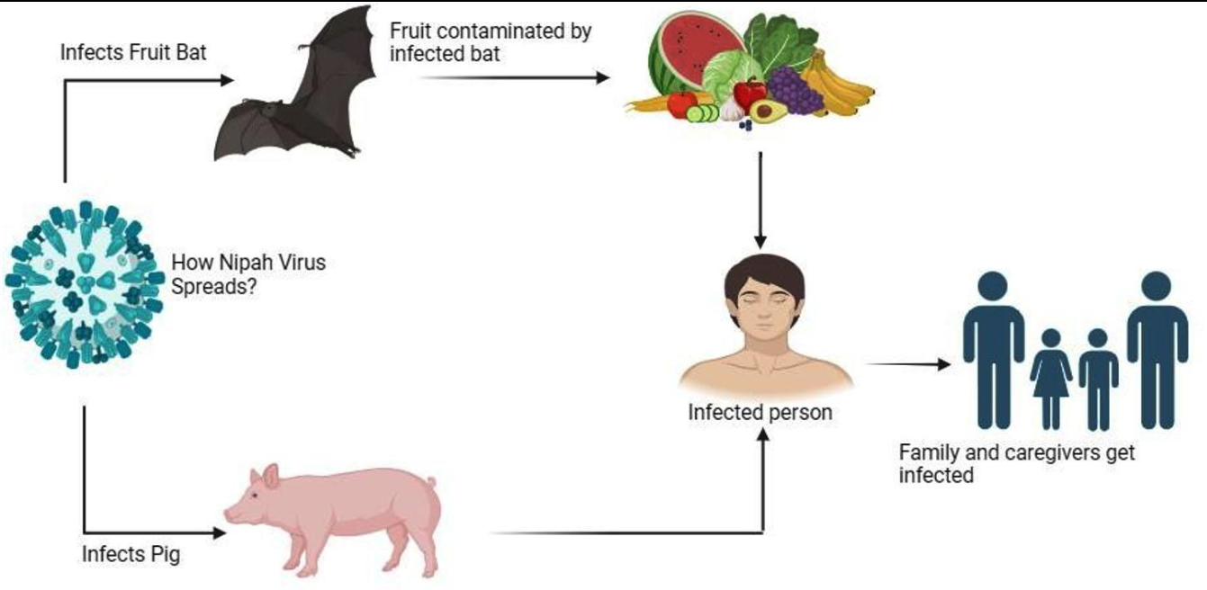
Objectives
1. Pathogenesis Analysis
Study molecular and cellular mechanisms of infection.
2. Epidemiological Assessment
Analyze recent outbreak patterns and transmission dynamics.
3. Strain Comparison
Compare Malaysian strain (NiV-M) and Bangladesh strain (NiV-B).
4. Therapeutic Evaluation
Examine monoclonal antibodies and vaccine candidates.
5. Future Preparedness
Understand surveillance systems and future clinical trial frameworks.

Slide 4
Methodology
Systematic review conducted using:
WHO reports
PubMed
BMJ Open
NCDC and ICMR surveillance data
Inclusion Criteria: Studies from 2015–2026 ≥100 confirmed cases
Validated genomic studies
Analysis included:
Strain comparison
Clinical symptom evaluation
Epidemiological trend analysis.
This systematic review synthesises epidemiological, clinical, and genomic data to evaluate NiV pathogenesis, strain divergence, viral kinetics, and the latest countermeasure pipeline.

Slide 5

Virology and Cellular Pathogenesis
Genome
Single-stranded, negative-sense RNA ~18.2 kb encoding 6
structural proteins
Entry Mechanism
G protein binds ephrin-B2/B3 receptors on endothelial, respiratory, and neuronal cells — enabling systemic infection
Immune Evasion
Viral P gene products suppress host interferon signalling,
enabling rapid replication
Pathology
Microvascular destruction → thrombosis, ischemia, CNS inflammation; virus persists causing relapsing encephalitis

Slide 6
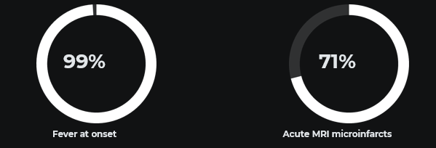
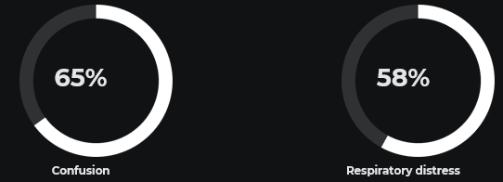
Clinical Features
Major Symptoms Observed
Symptom | Prevalence
Fever | 99%
Headache | 70%
Confusion | 65%
Altered Consciousness | 62%
Breathing Difficulty | 58%

Slide 7
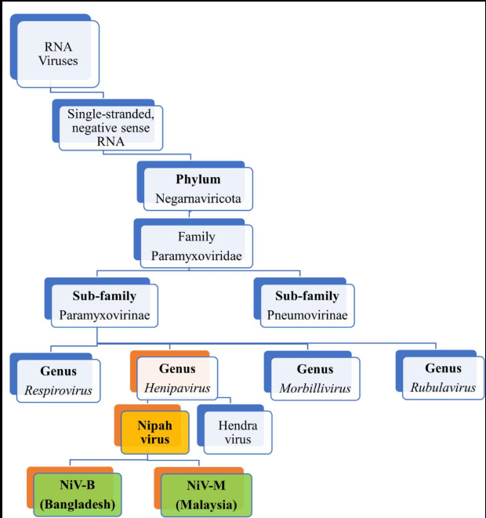
Strain Divergence (NiV-M vs NiV-B)
Clinical Feature | NiV-M | NiV-B
Cough | 16% | 49%
Shortness of Breath | 2% | 51%
Headache | 87% | Moderate
Myoclonus | 51% | Lower

Slide 8
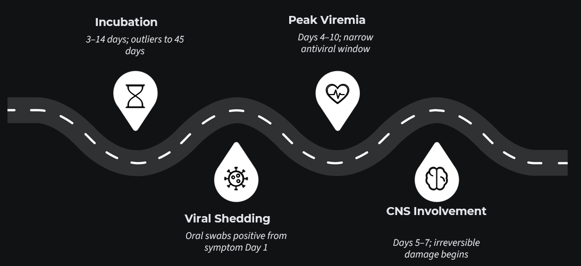
Viral Kinetics & Therapeutic Window
Mortality is strongly associated with degree of neurological depression, autonomic dysregulation, and baseline viral load. Standardised supportive care protocols are essential for reliable clinical trial data across regions.

Slide 9

Epidemiological Evolution (2025–2026)
Location | Cases | CFR
Malaysia | 276 | 38%
Bangladesh | 300+ | ~67%
Kerala | 23 | 91%
West Bengal | Cluster | High
Key Findings
Expansion into new regions
Nosocomial (hospital-acquired) transmission
Increased spillover events in India & Bangladesh.

Slide 10

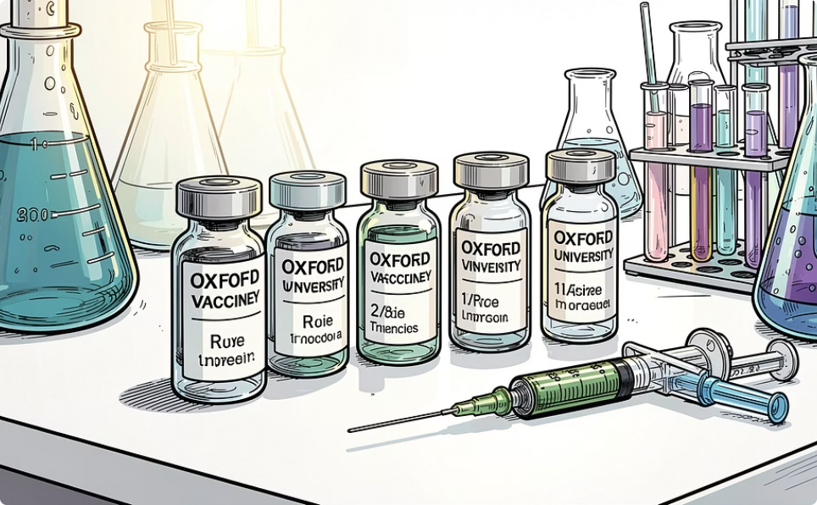

Medical Countermeasures
Hu1F5 Monoclonal Antibody
ChAdOx1 NipahB Vaccine
Targets F glycoprotein in its pre-fusion state, blocking viral entry and syncytia formation. 100% survival in non-human primate studies. CEPI-supported Phase 1b/2a trials launching in India and Bangladesh.
Replication-deficient chimpanzee adenovirus vector. Phase II trials launched December 2025 (University of Oxford, Bangladesh). Serum Institute of India (SII) building a 100,000-dose reserve for ring vaccination deployment.

Slide 11
Surveillance & One Health Approach
BASE Cohort Study
Longitudinal monitoring of 2000 patients.
90-day neurological follow-up.
Rapid Diagnostic Tools
RT-LAMP assays
Decentralized testing systems
One Health Approach
Integrated coordination between:
Human healthcare
Wildlife surveillance
Agricultural management

Slide 12
Conclusion
Final Summary
Nipah Virus is one of the most dangerous emerging zoonotic pathogens.
Dual respiratory and neurological tropism increases severity.
Recent outbreaks highlight urgent need for preparedness.
Vaccines and monoclonal antibodies offer promising future solutions.
Recommendations
Strengthen surveillance systems
Improve rapid diagnostics
Standardize clinical protocols
Expand vaccine development program

Slide 13
Thank You
‹#›

